Slide 1

Judging the Judge:
A Study on Perception of LLM vs Human
Decisions-Makers in Ethical Dilemmas
By Yalda Kasravi Mavi and Azalée Robitaille

Slide 2



Motivation Why Study Human Perception of LLMs in Ethical Dilemmas?
[Understand the divergence between LLM and humans in complex and ethically sensitive contexts]
[Highlight potential biases in human perception of AI-generated content]
[Influence of contrasting opinion (LLM generated or humans)]

Slide 3
Research Objectives Research Hypotheses and Questions
Explore perceptions of LLM vs human responses
Influence of Contrasting Opinions: assessing willingness to change initial answers after seeing differing opinions attributed to an LLM or a human

Slide 4
Research hypotheses
Hypothesis 1: Participants will perceive answers generated by LLMs differently from human-generated answers, with potential biases in how participants evaluate the credibility and reasoning behind the responses.
Hypothesis 2: Participants will be more likely to change their initial responses after being exposed to a differing opinion, with the likelihood of change being influenced by whether the differing opinion is attributed to a human or an LLM.
Precise
Testable
Interesting

Slide 5
Methodology
Mixed-methods approach: Combining qualitative and quantitative analyses
Participants recruited via social media and divided into two groups
Group B: Told answers to review come from another human participant
Analyze reasoning with qualitative
Analyze operationalization of perception with quantitative
Group A: Told answers to review come from ChatGPT
Holistic picture
Triangulate the truth

Slide 6
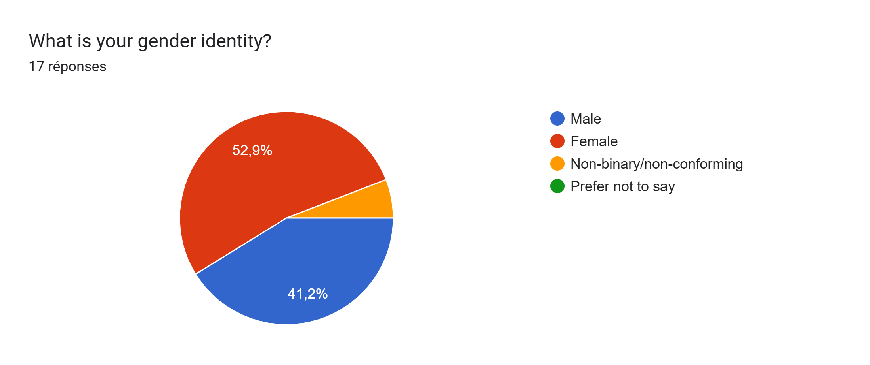
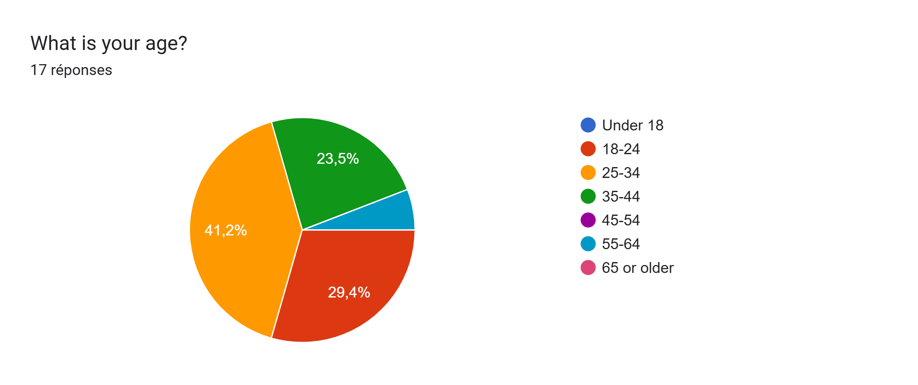
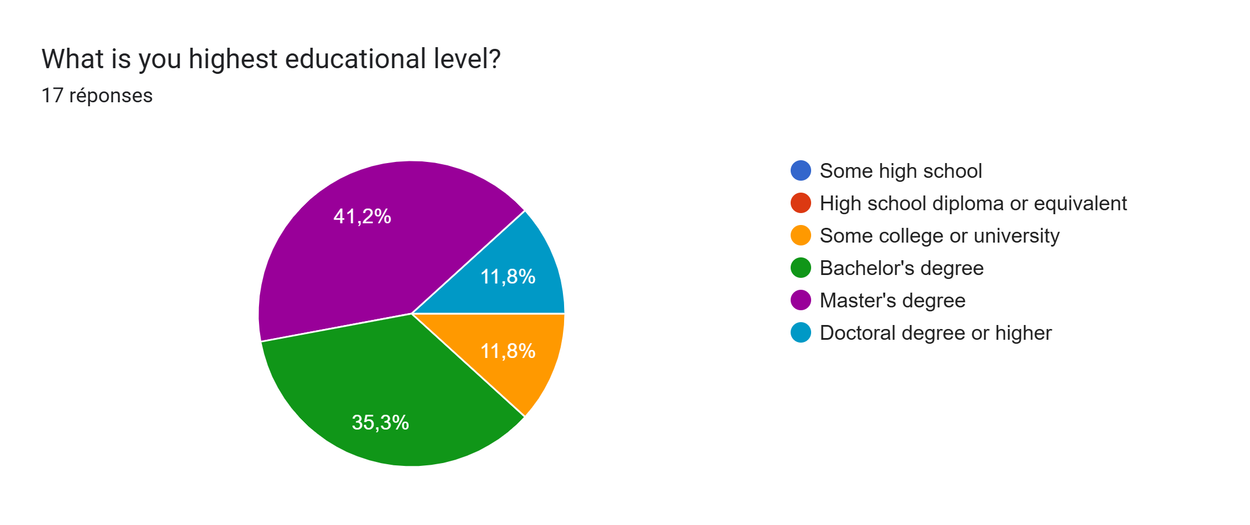
Methodology - Participants
Total Participants: 18 –1 = 17 (one didn't finish )
Background: Computer science, Engineering, Law, Nursing, Teaching, Social Work, Psychology, Geography ,…
Randomly assigned

Slide 7
Methodology - Study design
Deception study
Between subject
Qualitative:
Open-ended questions
Think-aloud – observation (jottings, notes, focused coding)
Quantitative :
LLM ( fixed, effect, correlation)

Slide 8
Variables
Dependent
Perception and Credibility of Responses
Willingness to Change Responses
Independent
Labeling of answers source: LMM or Human
Confoundign variables
Participant Characteristics
Familiarity with Moral Dilemmas
Personal Attitudes Towards AI

Slide 9
Methodology - Task Design
Part 2(Answer ethical dilemmas)
Answer for questions for four ethical dilemmas with multiple-choice questions
Part 3 (Review other answers)
Feedback
Rate agreement with other answers
Part 4 (Post-study survey)
Verbalize reasoning and explain choices
Difficulties during the survey
Revise initial answers if desired
Quantify the desire to change their original answer
Asses their confidence in original answers
Part1(Pre-study survey)
Demographic questions
Rate creadibility of the explanations, and reasonings

Slide 10
Task Design - Part 1 (Ethical dilemmas)
Autonomous Vehicle Scenarios (Number of lives saved, species, social attributes):
Kazuhiro Takemoto. The moral machine experiment on large language models. Royal Society open science, 11(2):231393, 2024.
Medical Resource Allocation (Patient health, age, contribution, recovery potential):
Naomi Laventhal, Ratna Basak, Mary Lynn Dell, Douglas Diekema, Nanette Elster, Gina Geis, Mark Mercurio, Douglas Opel, David Shalowitz, Mindy Statter, et al. The ethics of creating a resource allocation strategy during the covid-19 pandemic. Pediatrics, 146(1), 2020
Keegan Guidolin, Jennifer Catton, Barry Rubin, Jennifer Bell, Jessica Marangos, Ann Munro-Heesters, Terri Stuart-McEwan, and Fayez Quereshy. Ethical decision making during a healthcare crisis: a resource allocation framework and tool. Journal of medical ethics, 48(8):504–509, 2022
Angus Dawson, David Isaacs, Melanie Jansen, Christopher Jordens, Ian Kerridge, Ulrik Kihlbom, Henry Kilham, Anne Preisz, Linda Sheahan, and George Skowronski. An ethics framework for making resource allocation decisions within clinical care: responding to covid-19. Journal of bioethical inquiry, 17:749–755, 2020
Trolley Problem Variations (Social roles, relational proximity, moral justification):
Natalie Gold, Andrew M Colman, and Briony D Pulford. Cultural differences in responses to real-life and hypothetical trolley problems. Judgment and Decision making, 9(1):65–76, 2014.
April Bleske-Rechek, Lyndsay A Nelson, Jonathan P Baker, Mark W Remiker, and Sarah J Brandt. Evolution and the trolley problem: People save five over one unless the one is young, genetically related, or a romantic partner. Journal of Social, Evolutionary, and Cultural Psychology, 4(3):115, 2010.
Alessandro Lanteri, Chiara Chelini, and Salvatore Rizzello. An experimental investigation of emotions and reasoning in the trolley problem. Journal of Business Ethics, 83:789–804, 2008.
Workplace Dilemmas (Relationship type, personal gain, professional integrity):
Cheryl Lindy and Florence Schaefer. Negative workplace behaviours: an ethical dilemma for nurse managers. Journal of Nursing Management, 18(3):285–292, 2010.
John P Allegrante and Richard P Sloan. Ethical dilemmas in workplace health promotion, 1986.

Slide 11
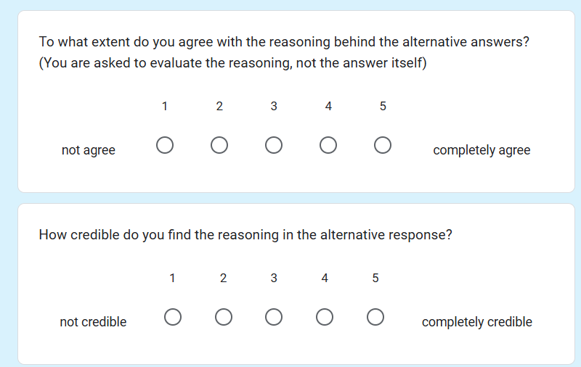
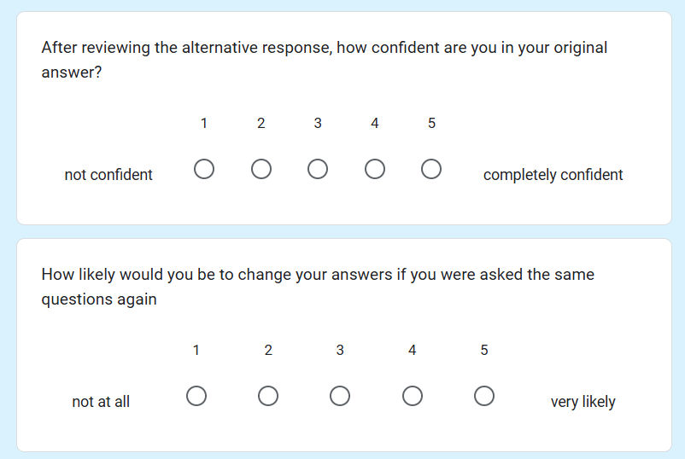
Task Design - Part 2 (Review answers from other participant)
Subjective measure

Slide 12
Task Design – Part 3 (Post-Study Survey)
For both groups:
All answers were generated by ChatGPT (predefined so always the same)
Same answers for 2 of dilemmas (chosen randomly)
Different answers for 2 of the dilemmas (chosen randomly)

Slide 13
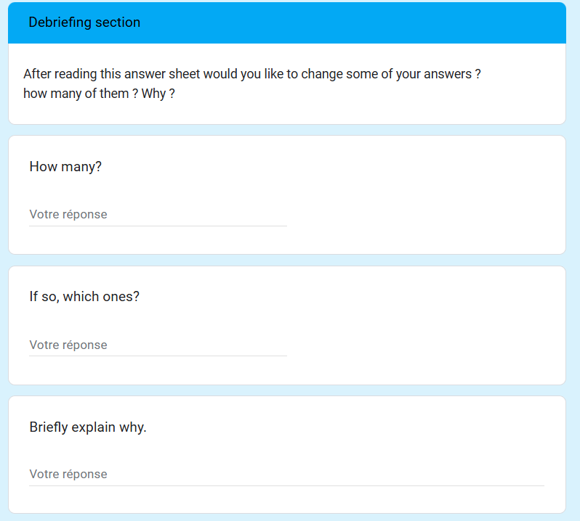
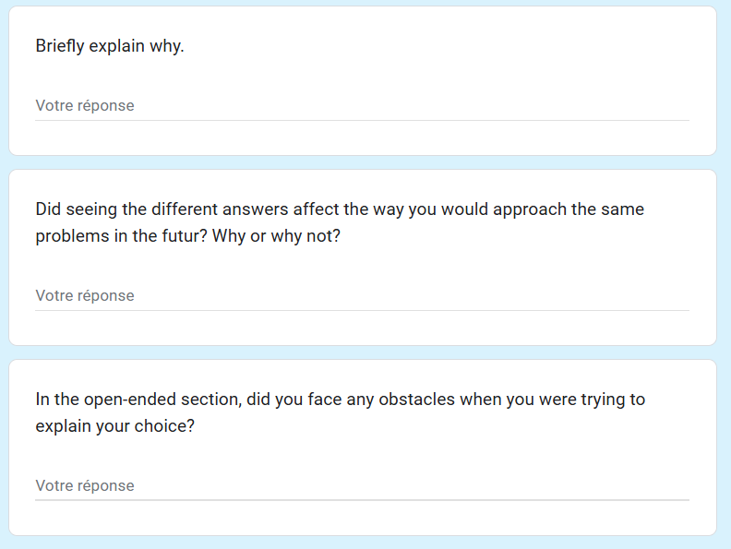
Task Design – Part 3 (Post-Study Survey)
Qualitative measures

Slide 14
Methodology - Analysis
Quantitative
Agreement scores, credibility assessments, confident in original answers, response change rates
Statistical models: LMM, post-hoc test (emmeans)
Thematic analysis for reasoning and critiques.
Inductive coding
Qualitative

Slide 15
Methodology – Qualitative Analysis
Inductive coding: Discover unique themes in participant justifications
Analyze critique language for patterns in trust, skepticism, and rationale
Compare patterns based on perceived source of answers(LLM vs. Human).

Slide 16
Methodology – Quantitative Analysis
Check the normality and variance
Calculate mean scores for agreement, logic, and other attributes.
Use Linear Mixed Models (LMM)
Post-Hoc test (emmeans) to analyze group interactions.

Slide 17
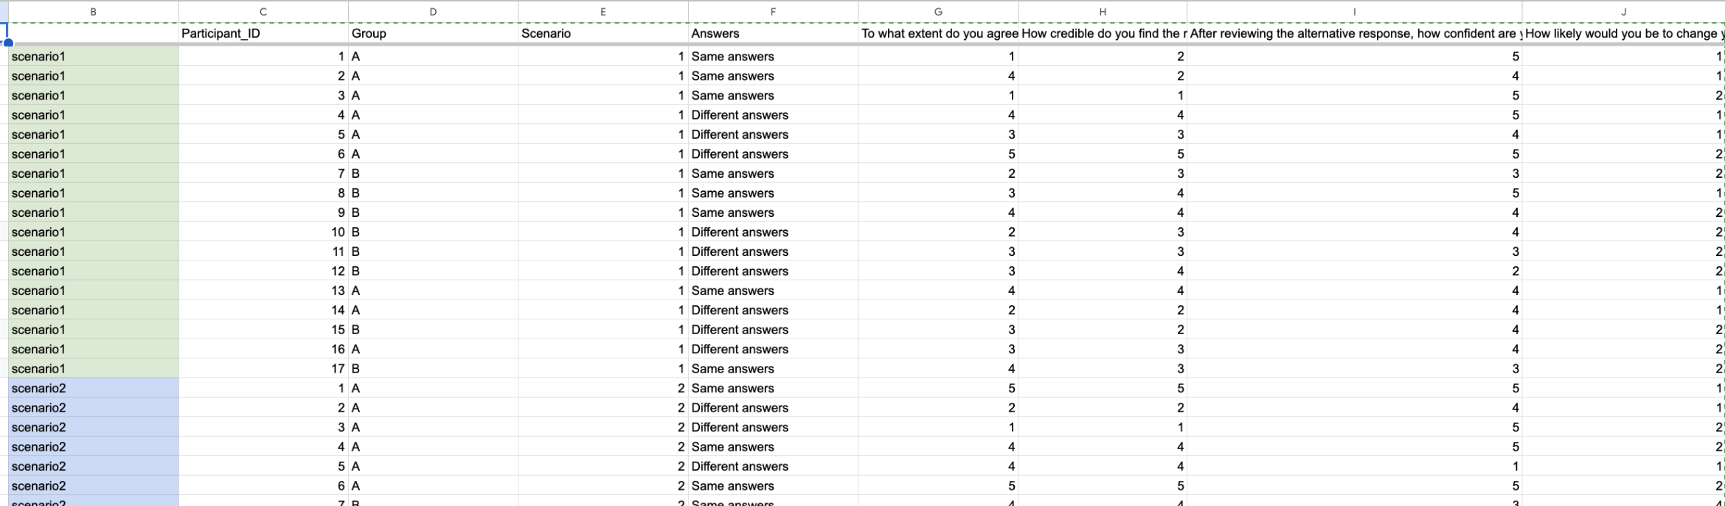
Findings - Quantitative
Is it normal?
yes
Centralize and clean data
Visualize data
no
Non parametric

Slide 18
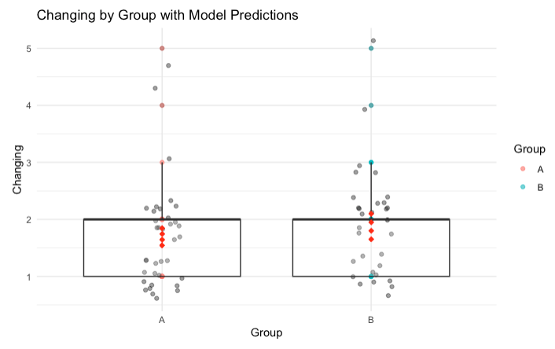
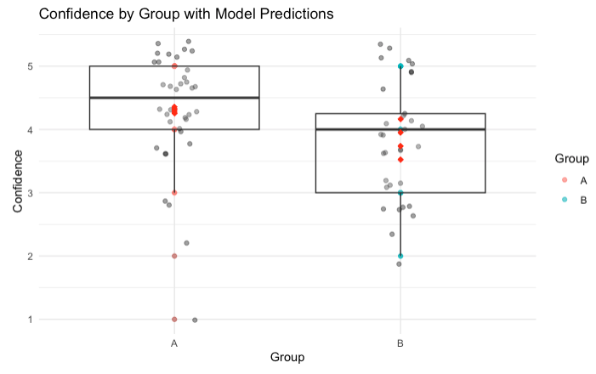
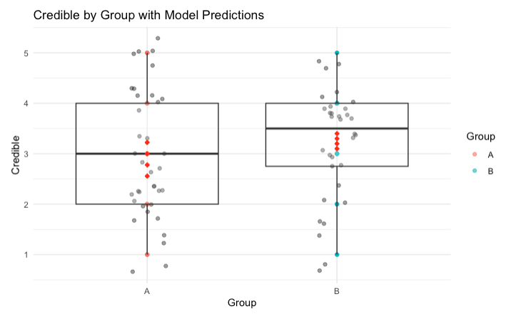
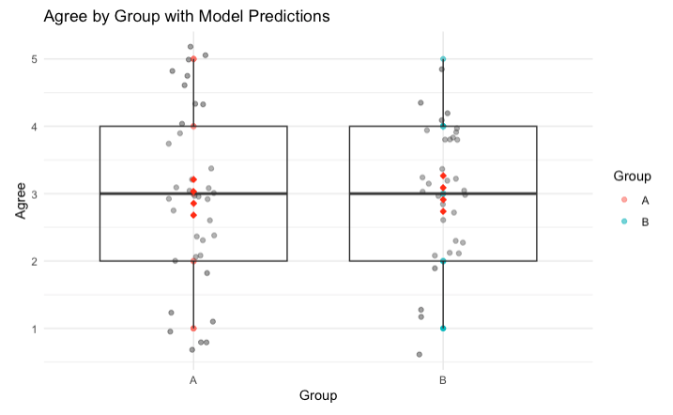
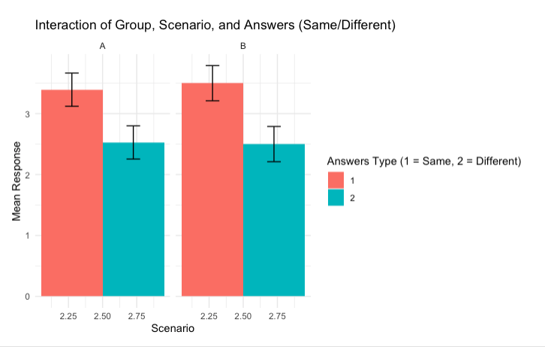
Findings - Quantitative
Group A
More defensive about their own justifications (confidence score)
Not willing to change their original answers( changing score)
Less defensive about their own justifications (confidence score)
Not willing to change their original answers( changing score)
Group B
More critical towards alternative perspectives (credibility score)
More open in undrestanding alternative perspectives/justifications (credibility score)
More value to differing opinions (agreeing score)
Not accepting different choices ( agreeing score)
Same or different responses had differences
Same or different responses had no difference

Slide 19
Findings - Qualitative
Group A
More defensive about their own anwsers
Only 2 participants changed 1 of their answers
6 participants changed at least one of their answer (some more)
Group B
More critical towards towards alternative perspectives/answers
More openeness towards alternative perspectives/answers
More value to differing opinions
Did seeing the different answers affect the way you would approach the same problems in the future? Why or why not?
Group A : ''No, it didn't, because I know the answers come from an AI.'' ,"I feel chat GPT’s responses were highly questionable."
Group B: ''Yes, seeing different answers can affect the way I approach problems in the future, as it can provide new insights and methods to consider.''

Slide 20
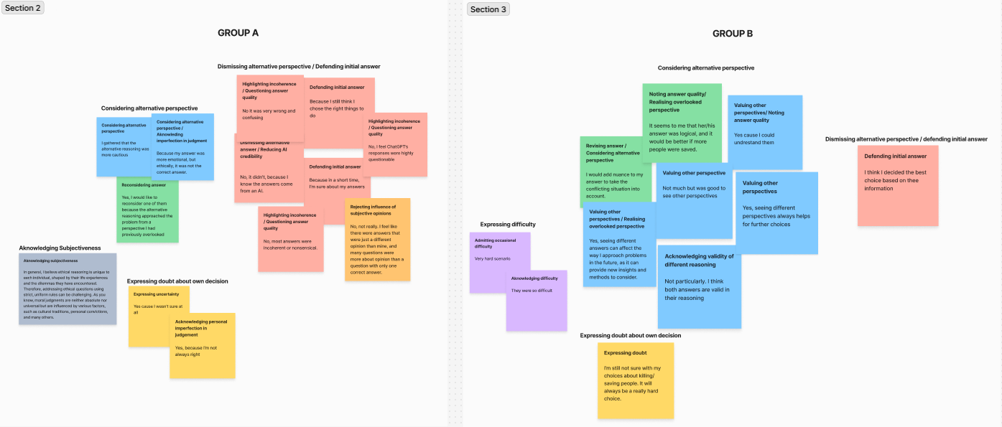
Findings - Qualitative

Slide 21
Discussion Skepticism towards AI ?
Participants are more open-minded and less critical when they think the answers are from another human participant
Participants do not trust Ai judgement in terms of ethics
Answers are less credible if they come from AI
Participants are more confident in their answers when they compare with AI

Slide 22
Threats to validity
Internal validity:
Order Effects: If all participants were exposed to the same dilemmas in the same order, their responses might be influenced by earlier dilemmas. (Randomize the dilemmas)
Demand Characteristics: If participants guess the purpose of the study, they might alter their responses to align with what they think the researchers want to hear, affecting the accuracy of the data.
External validity:
Sample Bias: If participants are not representative of the general population (check with pre-study survey)
Artificial Setting: the study is conducted in a controlled environment, participants might behave differently than they would in a real-world setting (questions are very hypothetical), which can limit how well the findings generalize to everyday situations.
Threats to ecological validity:
Artificial Moral Dilemmas: the moral dilemmas in the study is overly complex compared to the complex moral dicission people make in everyday life, so the results aren't true to real-worl situations.it soesnt accurately reflect how people make moral decisions in real life. (check with post-study survey)
Lab Environment: Conducting the study in a lab can make it feel like an artificial situation, which might not represent how people typically interact with AI or make moral judgments in real-world contexts

Slide 23
Q&A
Questions?

Slide 24
Thank you!

